Slide 1

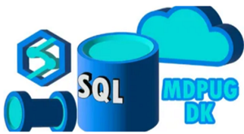
An easy way to process complex XML/JSON file using Azure Data Factory

Slide 2
Abstract
In this session, We will see a quick overview of ADF and later on we will see a demo using Data Integration pipeline.
We will see how to process complex json/xml file using Azure Data Factory and moving data to Azure SQL Server. With No code or Low code solution.
At the end of session, you will get basic ideas about following Azure services.
1. Azure Data Factory
2. Azure Key Vault
3. Azure Storage Account
4. Azure SQL Server
5. XML file having array or array or Complex XML object
The main goal of this session is to show a demo
so attendee will leave with ideas about how to use it in their business outcome.

Slide 3







Alpa Buddhabhatti
She/Her Lead Azure Data Engineer/Trainer
Microsoft Certified Trainer(MCT)
Azure Developer(AZ-204)
Azure Data Engineer(DP-203)
Azure Data Scientist(DP-100)
@AlpaB7
alpabuddhabhatti
alpaBuddhabhatti
@meetalpa
@alpabuddhabhatti
https://maven.com/alpa-buddhabhatti/adft

Slide 4
Agenda
1. Azure Data Factory Overview
2. Demos :
Process a Simple file using copy activity
Process a Slightly complex file using Copy activity
Process a Complex file using Data Flow activity
3. Q & A

Slide 5
1. Azure Data Factory Overview

Slide 6
What is Azure Data Factory(ADF)
A cloud-based data integration service that orchestrates and automates the movement and transformation of data.
Azure Platform as a Service (PaaS)
It is Serverless
Only pay for what you have use
Low-code and no-code Solutions

Slide 7
What are Key Components?
1
Linked services
2
Datasets
3
Activities
4
Pipelines
5
Triggers

Slide 8

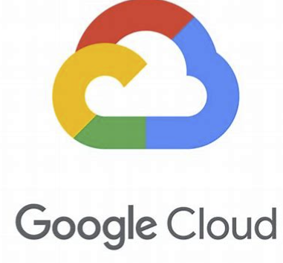
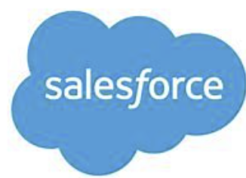

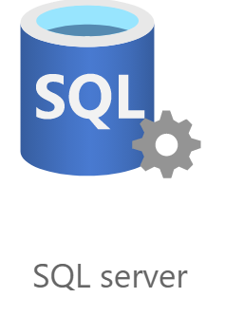
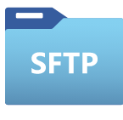






What can you do in ADF?
Data Movement
COPY DATA
~100
Copy activity - Azure Data Factory & Azure Synapse | Microsoft Docs

Slide 9

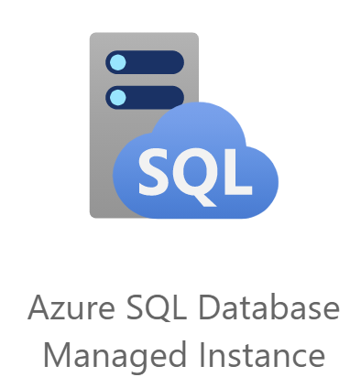

What can you do in ADF?
Data Transformation
TRANSFORMATION
~18
Source transformation in mapping data flow - Azure Data Factory & Azure Synapse | Microsoft Docs

Slide 10

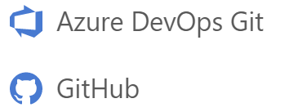


What can you do in ADF?
Pipelines are JSON, ready for Source Control
Built in Git Integration
Monitor
Manage

Slide 11

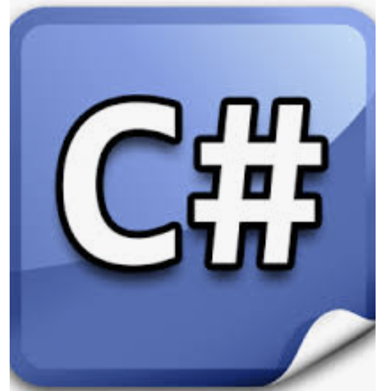

What can you do in ADF?
A Specific Time
File created or deleted from Blob Storage
Customer Activity such as
Trigger pipeline

Slide 12
What can you do in ADF?
Data Movements
Data Transformation
Easy to integrate
Orchestration
Automation

Slide 13
2. Demos

Slide 14
2.1 Demo
Process a Simple xml file using copy activity

Slide 15
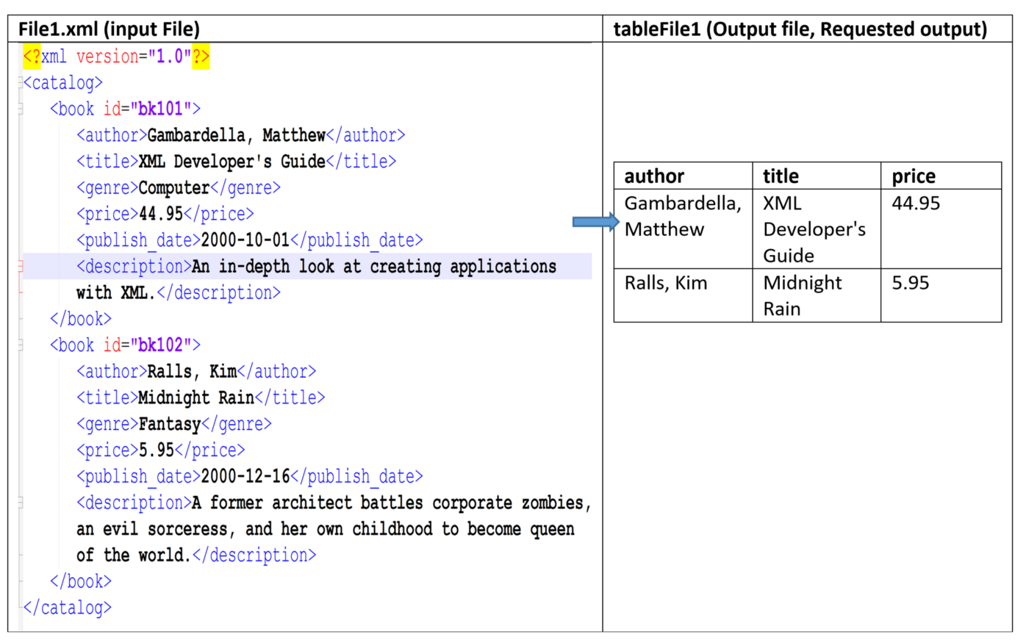
Demo1

Slide 16
2.2 Demo
Process a Slightly complex xml file using Copy activity

Slide 17
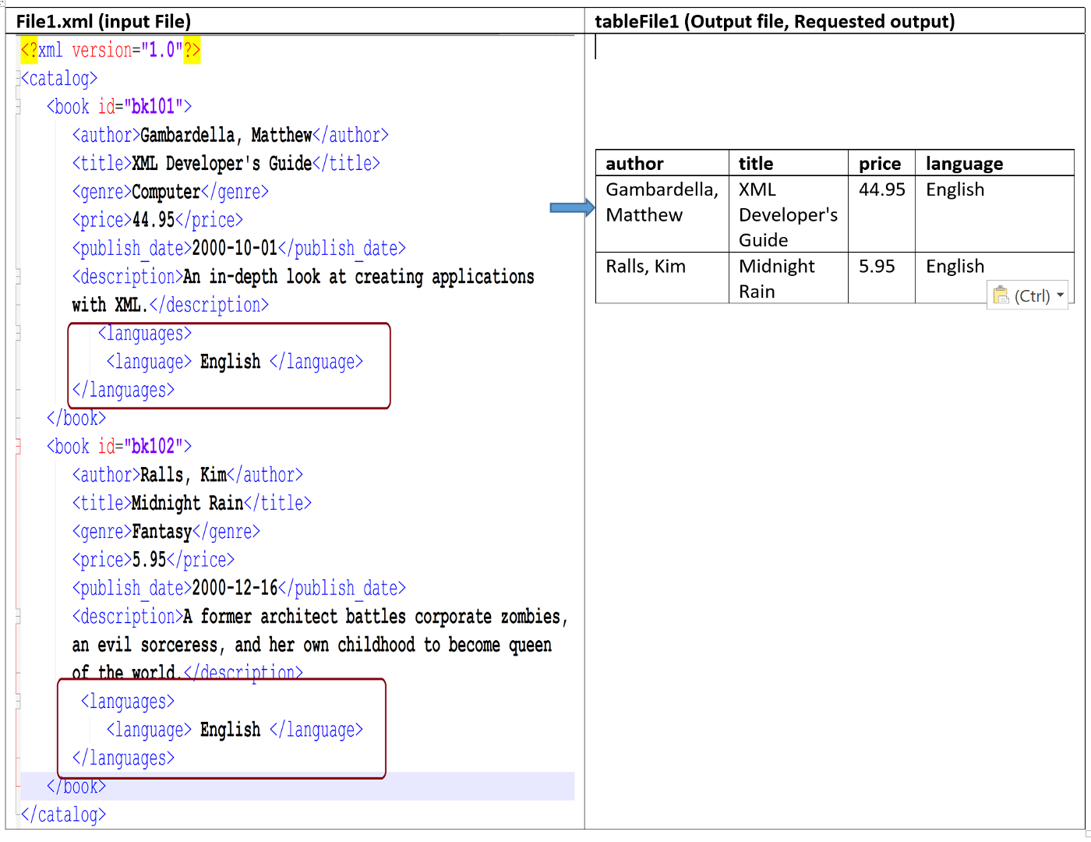
Demo2

Slide 18
2.2 Demo
Process a Complex xml file using Data Flow activity

Slide 19
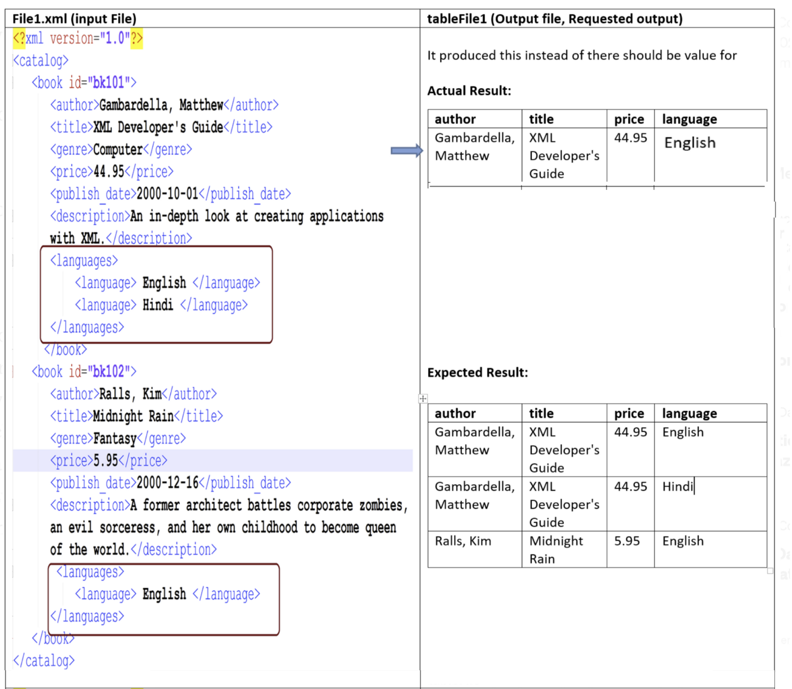
Demo3(Copy Activity)

Slide 20
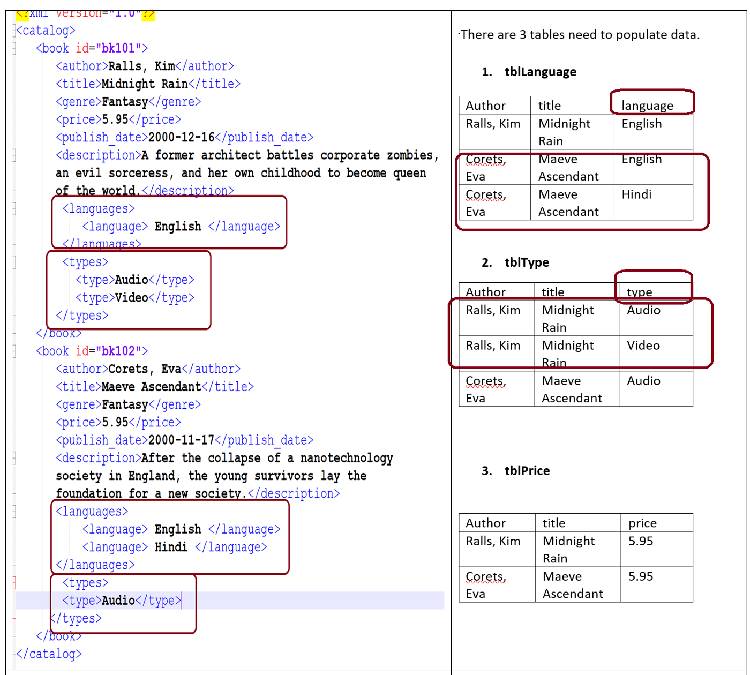
Demo 3(Data Flow Activity)

Slide 21
Alpa Buddhabhatti
She/Her
Lead Azure Data Engineer/Trainer
MCT, AZ-204, DP-203,DP-100, AZ-900
@AlpaB7
Thank you !!!
alpabuddhabhatti
alpaBuddhabhatti
@meetalpa
@alpabuddhabhatti
Online training - https://maven.com/alpa-buddhabhatti/adft Send me an email Meetalpa@gamil.com so that I can generate a discount code for you

